Slide 1
The UK property market: To buy or not to buy
Data – not Feelings

Slide 2
Let’s look at some data
Nationwide house price data
https://www.nationwidehousepriceindex.co.uk/resources/
ONS data: GDP and GDP per capita
https://www.ons.gov.uk/economy/grossdomesticproductgdp/timeseries/ihxw/pn2
https://www.ons.gov.uk/economy/grossdomesticproductgdp/timeseries/ihxt/pn2
Nominal or real values
Property as inflation hedge

Slide 3

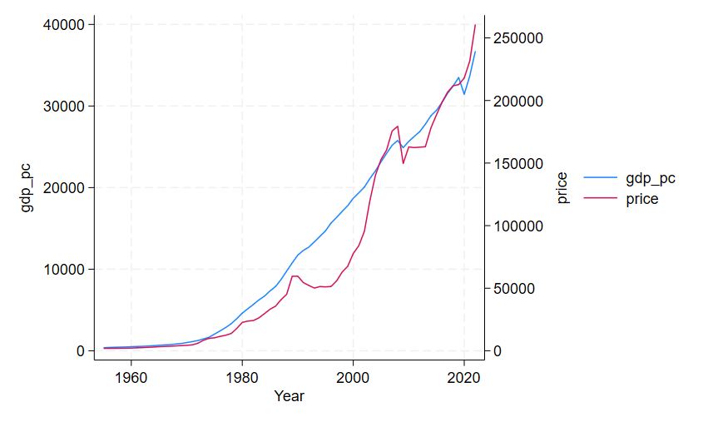
Prices and GDP per capita
Common ratios include price-income ratios
BUT: household composition has changed
Work patterns have changed
There might be a long-term equilibrium: affordability and rental income

Slide 4
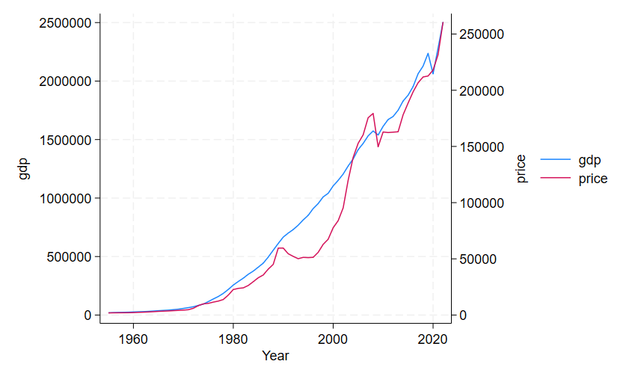
Prices and GDP
Measure of size of the economy
Population change reflected

Slide 5
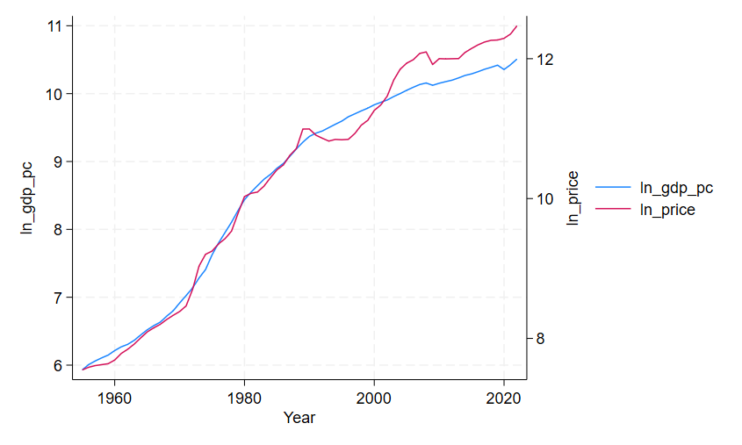
Log scale
Taking log prices and GDP per capita
Reveals exponential growth
Period of less growth
Over – and undervaluation

Slide 6
Initial assessment … more analysis needed
Prices tend to develop in line with economic growth
Property is a good inflation hedge – see video on gold prices
House price growth tends to exhibit serial correlation
Swings in the market making it more predictable
What to expect?
Is it time to buy or sell?

